Slide 1

Pre-training for OCR
Reporter: Jingye Chen

Slide 2
Overview
1
Background of OCR
2
Two pre-training methods for OCR
3
Conclusion

Slide 3
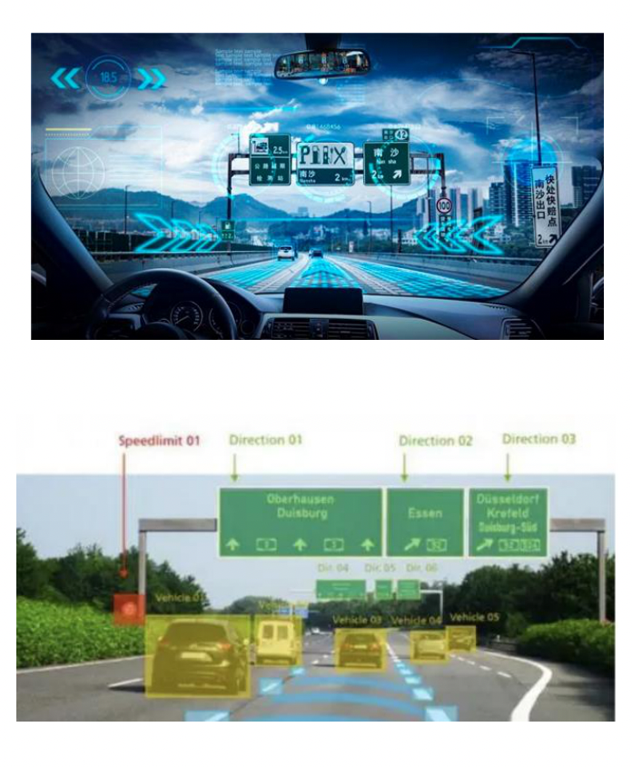
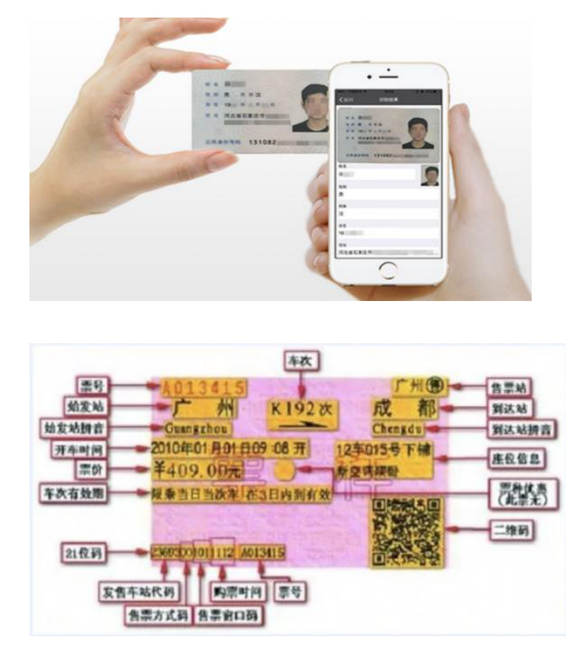
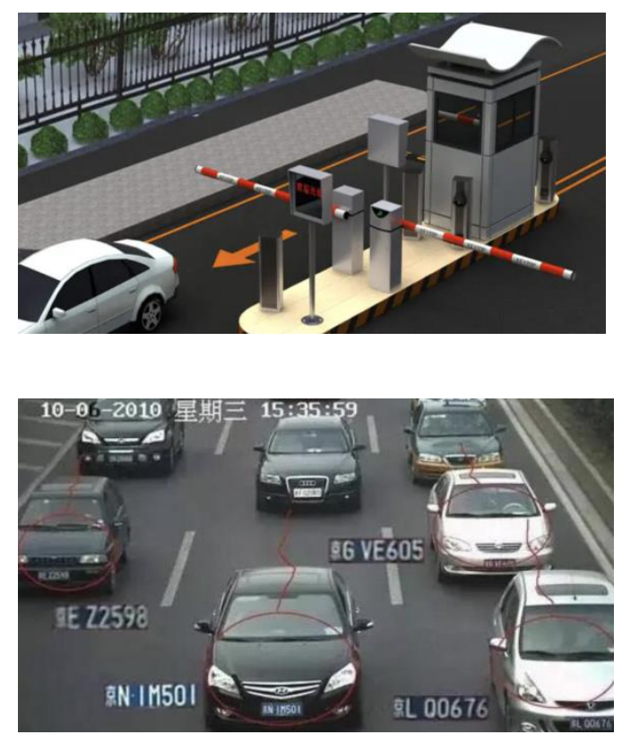
Part1
Background
of OCR
OCR is widely used in many real-world applications, such as autonomous drving, document analysis, license recognition, etc.

Slide 4
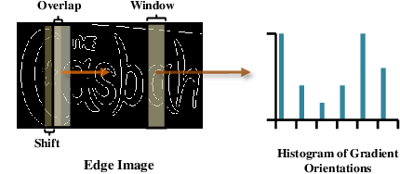
Part1
Background
of OCR
Some traditional OCR methods first convert original images to edge images, then extract the histogram of gradient orientations as discriminative features.
* Whole is Greater than Sum of Parts: Recognizing Scene Text Words. ICDAR2013.

Slide 5
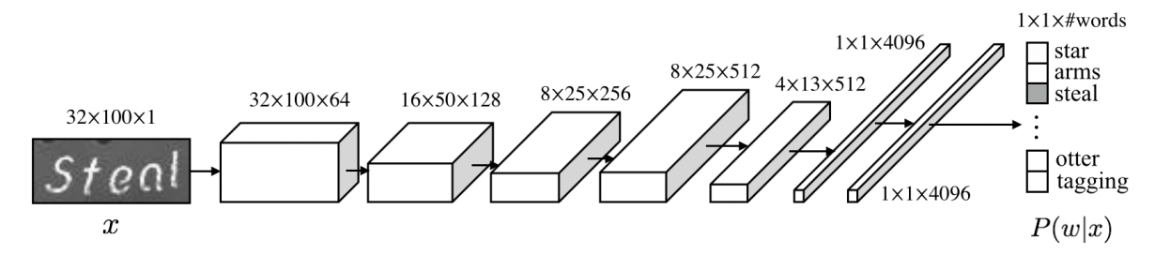
Part1
Drawback: The recognizer fails to recognize those words that are not in the 90k lexicon!
Background
of OCR
Jaderberg et al. treated ocr as a simple classification task, e.g., map each image to an 90k latent space for classification.
* Reading Text in the Wild with Convolutional Neural Networks. CVPR2014.

Slide 6
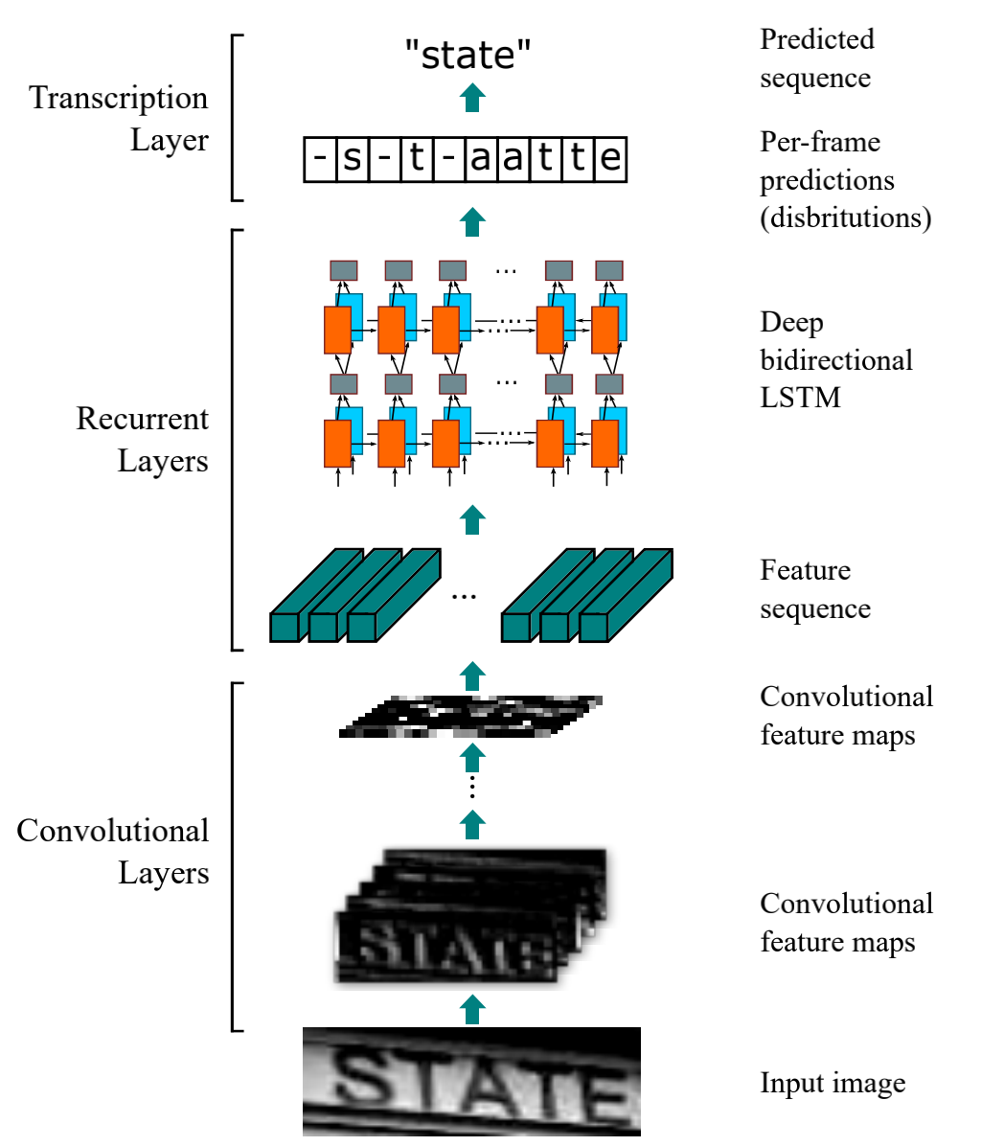
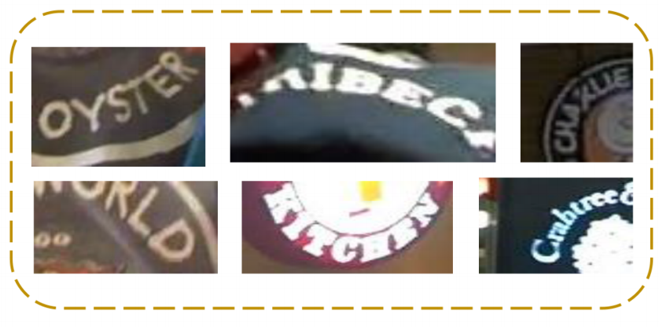
Drawback: CRNN compress each text images into 1-D feature maps, making it difficult to recognize irregular text images.
Part1
Background
of OCR
CRNN is one of the first deep-learning-based OCR methods that leverages CNN and BLSTM to extract features, then uses CTC loss for supervsion. CRNN first utilizes 15M synthesized text images for training, then fine-tune on real-world text images.
* Towards End-to-end Text Spotting with Convolutional Recurrent Neural Networks. CVPR2016.

Slide 7
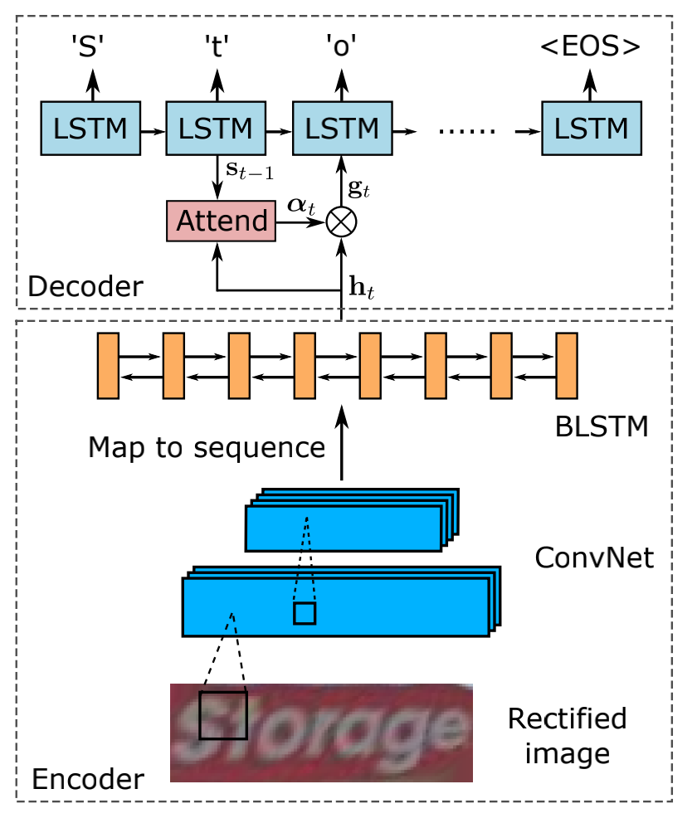
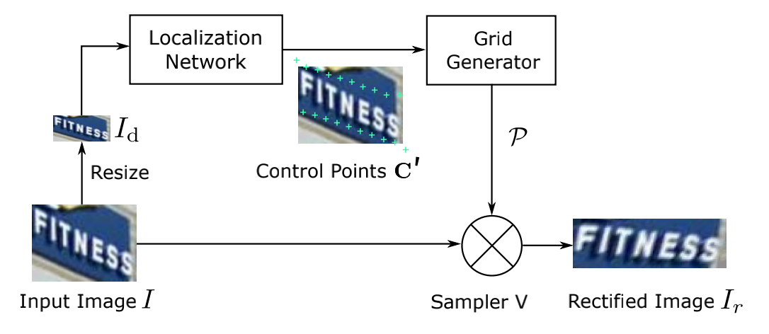
Drawback: Even though a rectifier is used, it is still difficult to tackle vertical texts.
Part1
Background
of OCR
ASTER first uses a spatial transformer network to rectify irregular text images, then uses an attention-based framework for recognition.
* ASTER: An Attentional Scene Text Recognition with Flexible Rectification. CVPR2016.

Slide 8
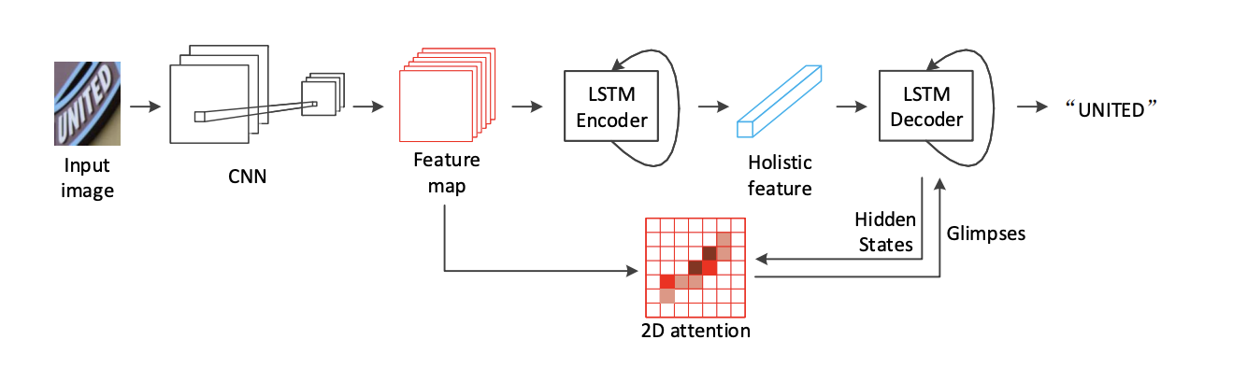
Part1
Drawback: The model highly relies on visual cues, ignoring the importance of lingustic information.
Background
of OCR
For better recognizing irregular text images, SAR utilizes 2-D features for decoding.
* Show, Attend and Read: A Simple and Strong Baseline for Irregular Text Recognition. AAAI2019.

Slide 9
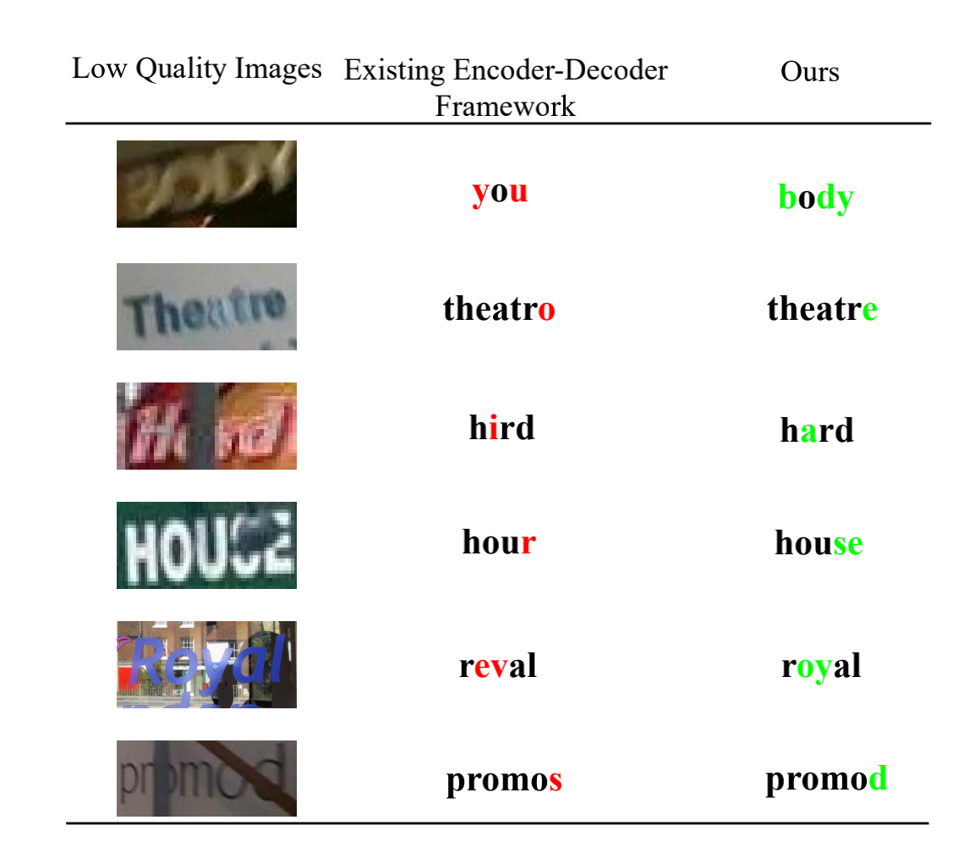
Part1
Background
of OCR
The metioned methods only highlight the importance of visual cues, whereas ignoring the pivotal role of lingual information.
Notes:
lexicon? or not

Slide 10
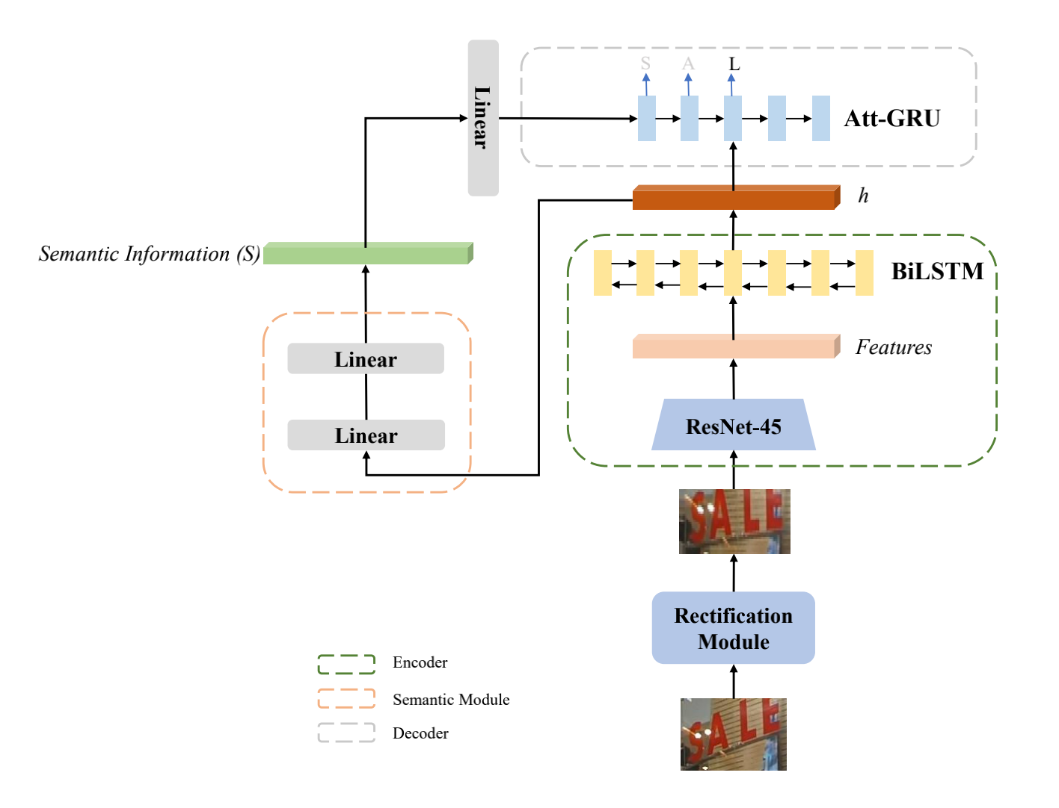
fastText embedding
Part1
recognition gt
Background
of OCR
Based on ASTER, SEED append a semantic branch supervised by fastText features to highlight the lingual information.
* Towards Accurate Scene Text Recognition with Semantic Reasoning Networks. CVPR2020.

Slide 11
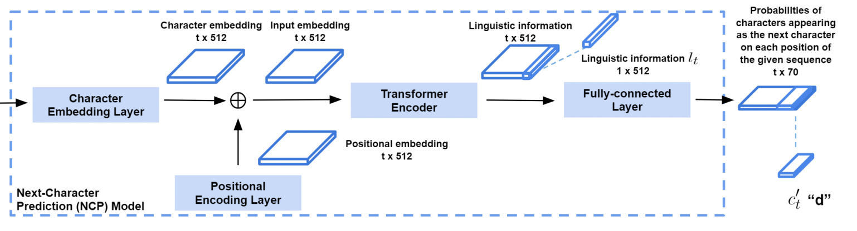
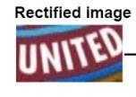
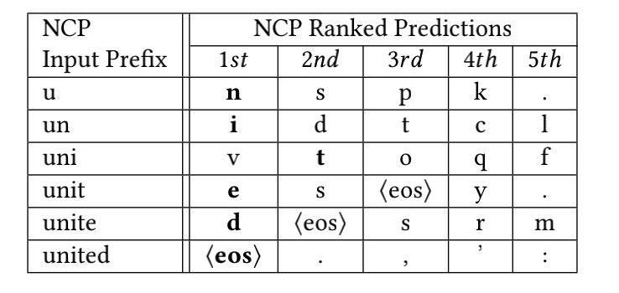
Part1
Background
of OCR
LAL pretrains a language model to model the next characters and combines it with the visual model.
* LAL: Linguistically Aware Learning for Scene Text Recognition. ACMMM2021.

Slide 12
Part1
The mentioned methods mainly exploit labeled text images for training.
There exists many unlabeled text images, which can also be used for pre-training.
Background
of OCR

Slide 13
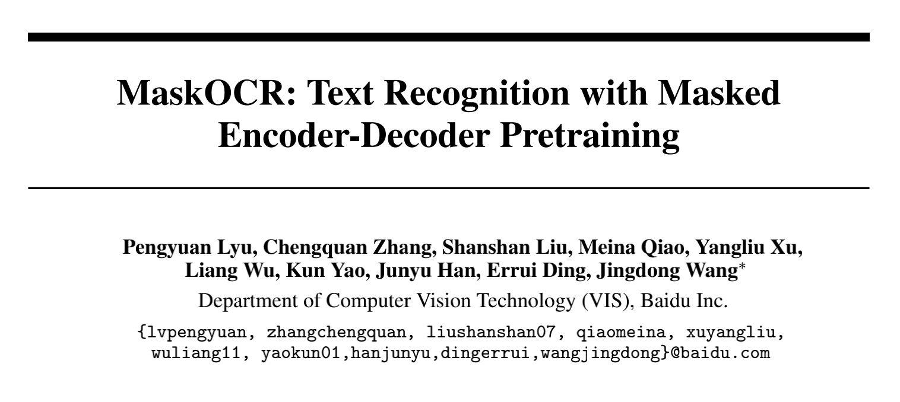
Part2
MaskOCR

Slide 14
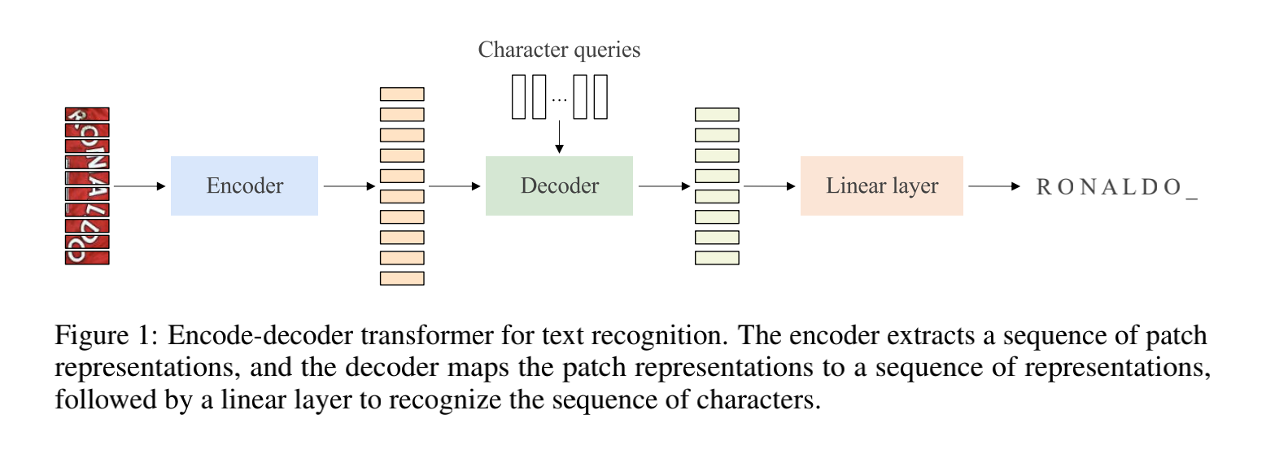
Part2
MaskOCR

Slide 15
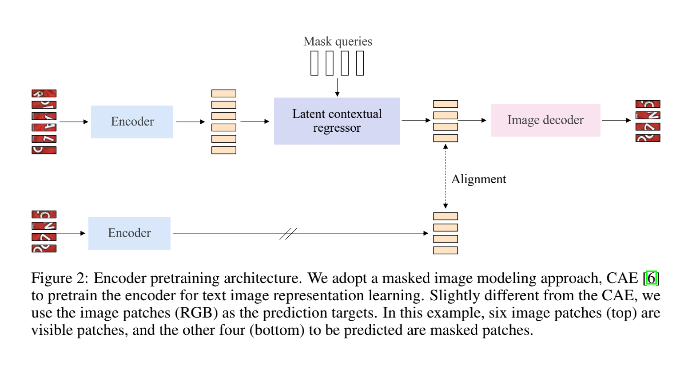
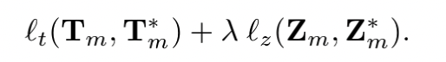
Part2
MaskOCR
Unlabelled real-world text images are used for pre-training the encoder.

Slide 16
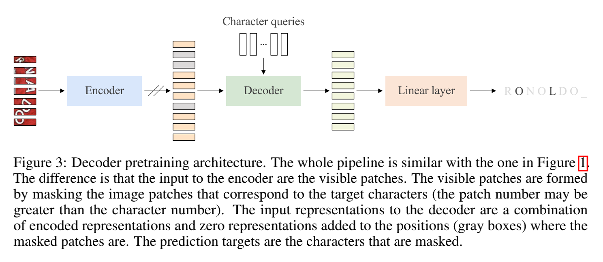
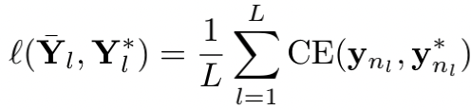
Part2
MaskOCR
Synthesized text images are used for pre-training the decoder.

Slide 17
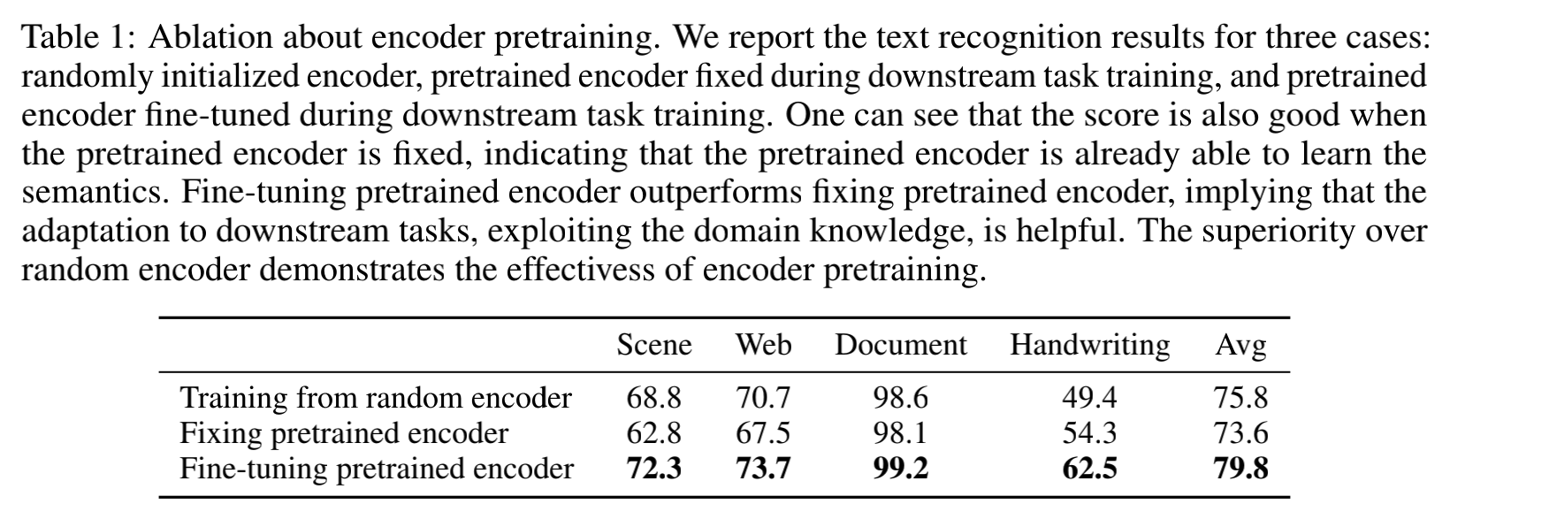
Part2
MaskOCR

Slide 18
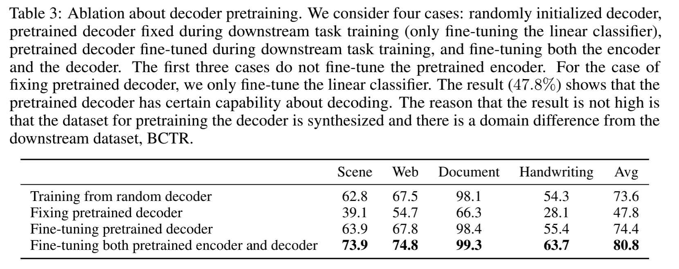
Part2
MaskOCR

Slide 19
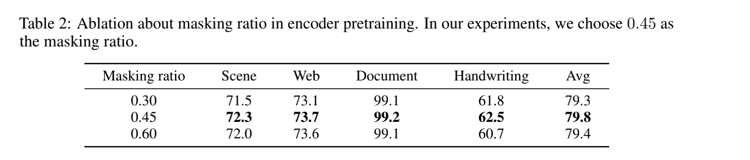
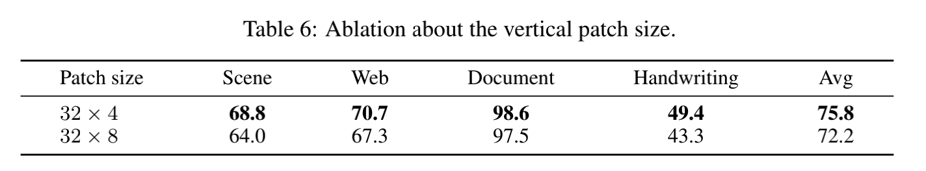
Part2
MaskOCR
The size of text images is set to 32x400.

Slide 20
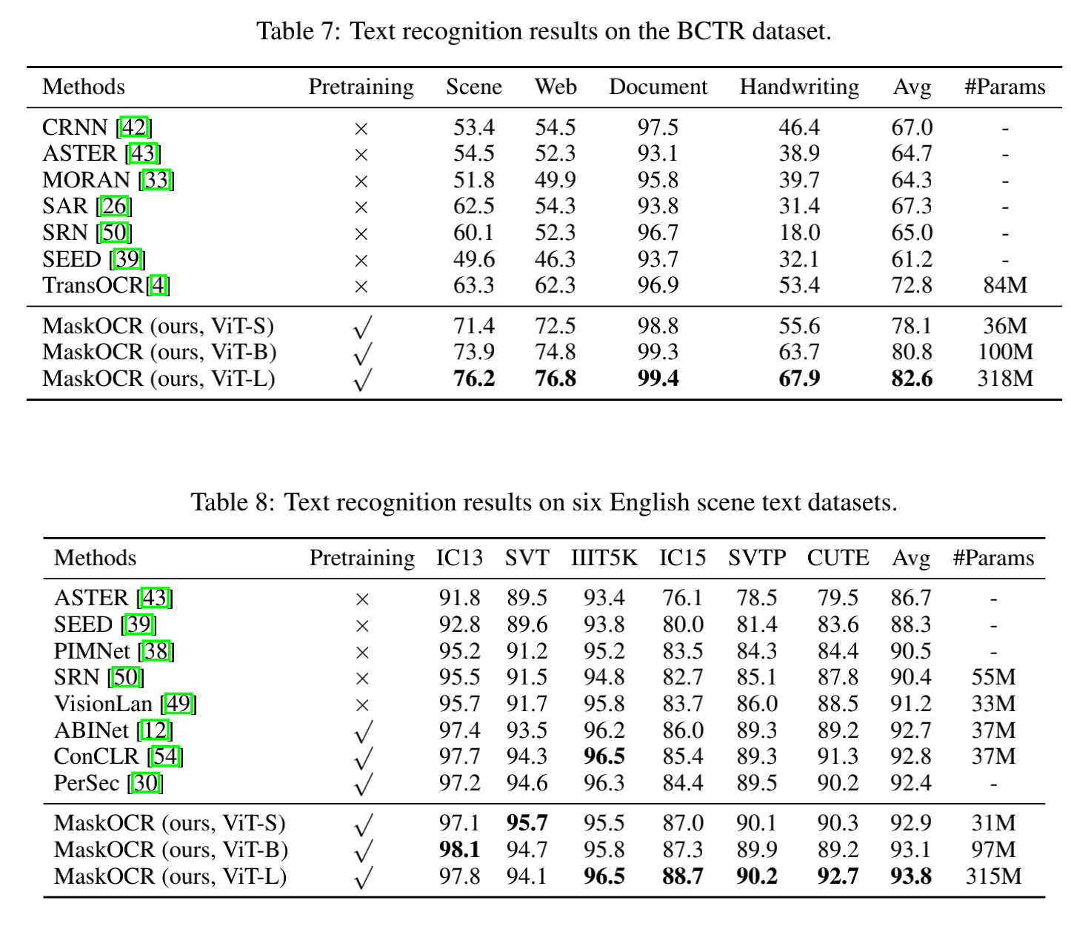
Part2
MaskOCR

Slide 21
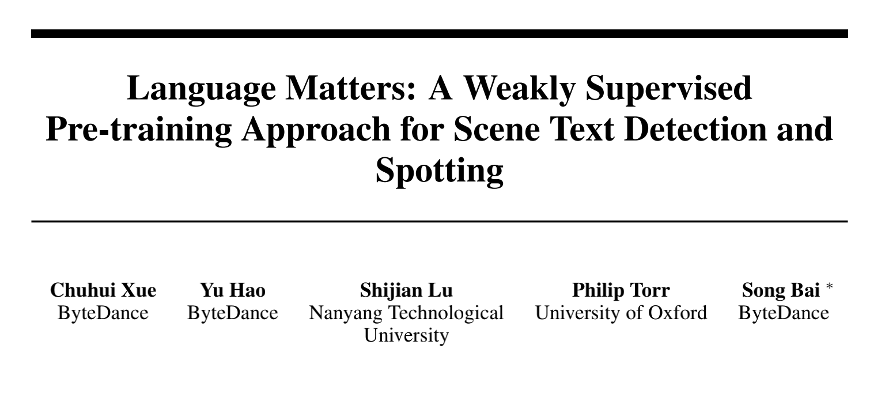
Part2
Language
Matters

Slide 22
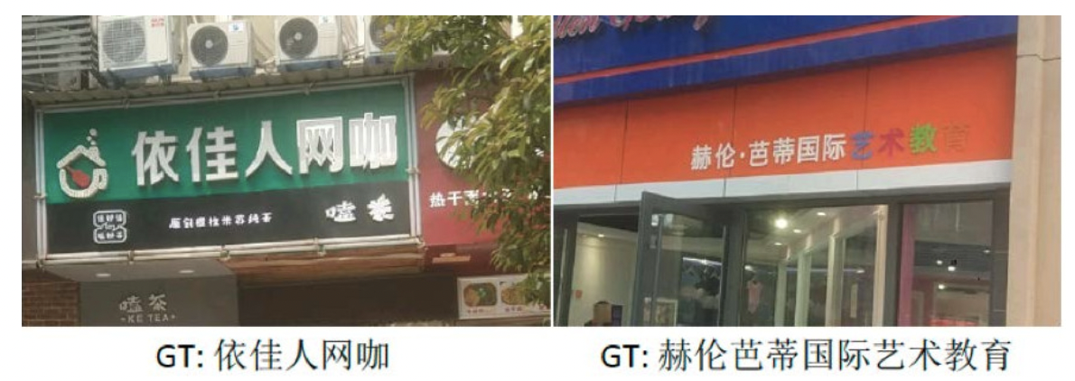
Part2
Language
Matters
There are some text images with partial labels.
How to utilize them to train the model?

Slide 23
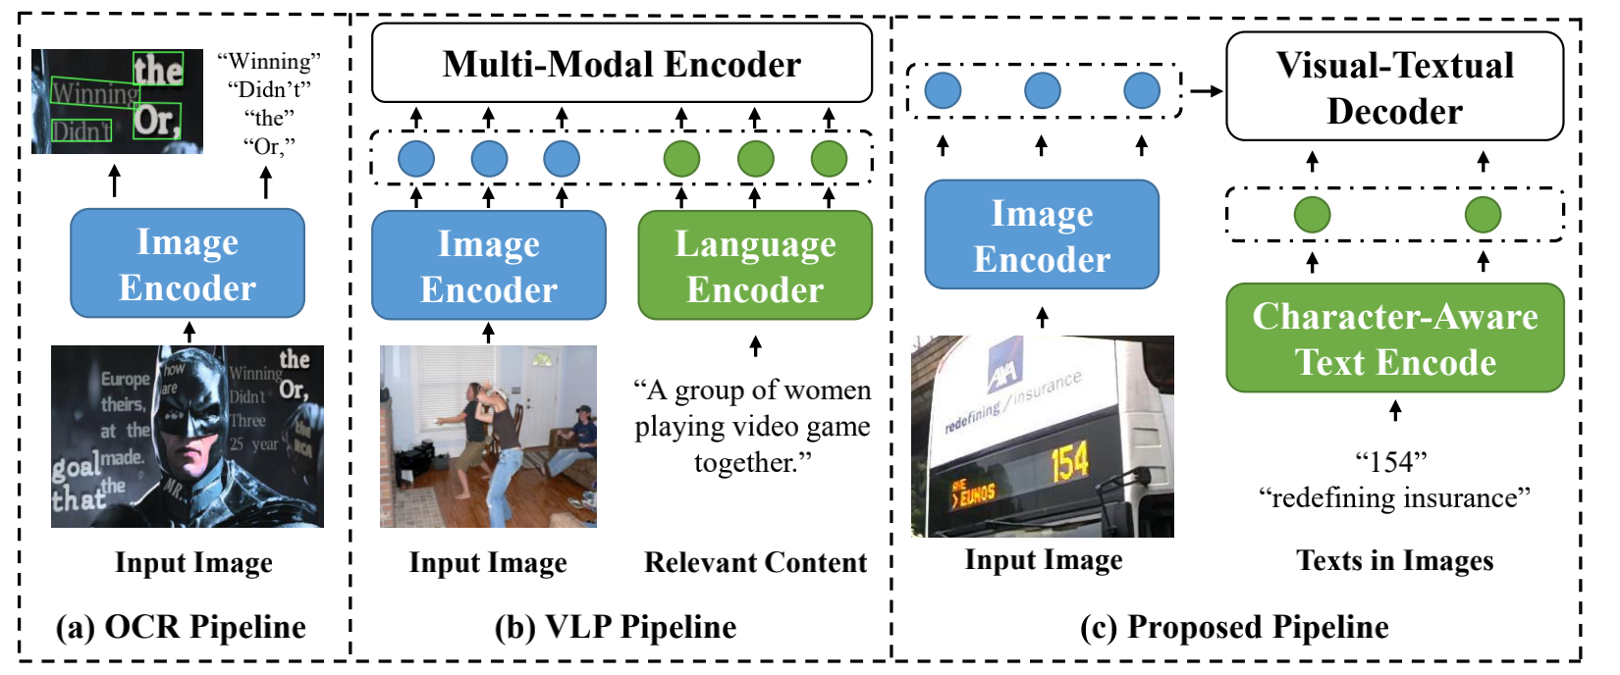
Part2
Language
Matters

Slide 24
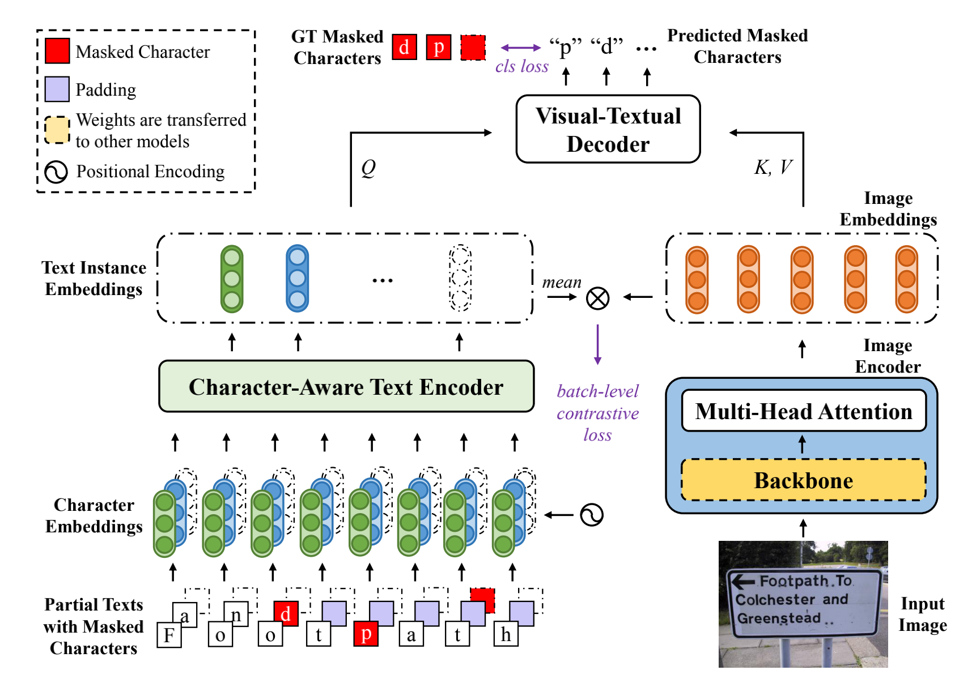
Part2
Language
Matters

Slide 25
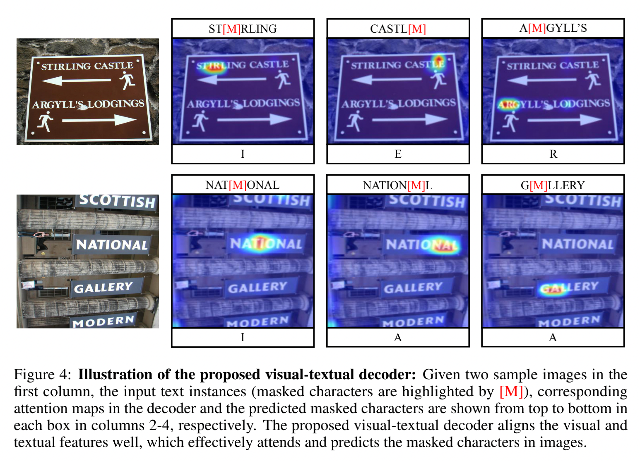
Part2
Language
Matters

Slide 26
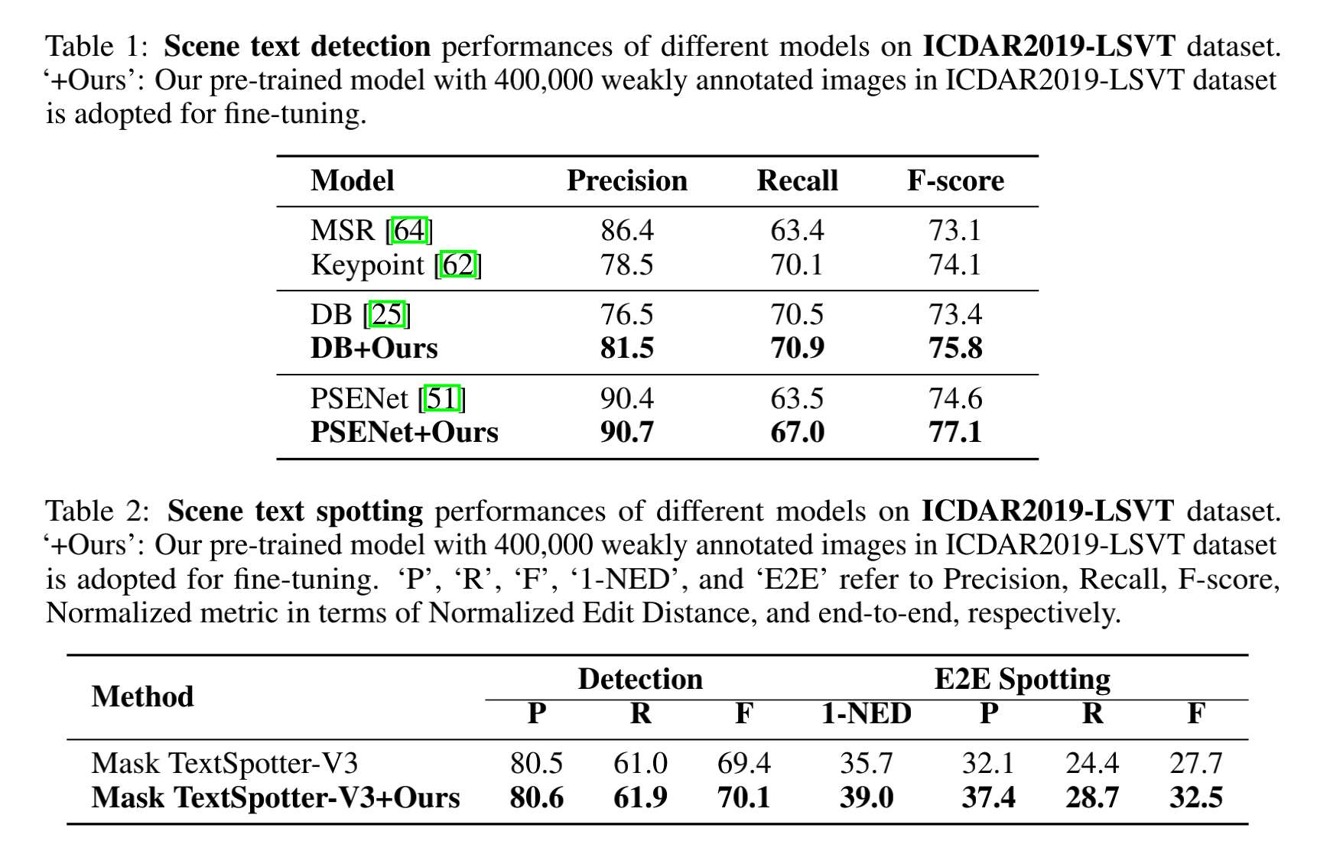
Part2
Language
Matters

Slide 27
Part3
How to use partially labeled samples to pre-train ocr models has become the current trend.
An increasing number of methods attempt to incorporate NLP
Conclusion

Slide 28
Thanks

